Slide 1
Machine Learning Techniques
K-Nearest Neighbour (KNN)
Instructor: Najam Aziz

Slide 2
K-Nearest Neighbor (KNN)

Slide 3
The Nearest Neighbour Algorithm
In 1967, the Nearest Neighbour algorithm was conceived, which was the beginning of basic pattern recognition.
This algorithm was used for mapping routes and was one of the earliest algorithms used in finding a solution to the traveling salesperson’s problem of finding the most efficient route. Using it, a salesperson enters a selected city and repeatedly has the program visit the nearest cities until all have been visited.
Marcello Pelillo has been given credit for inventing the “nearest neighbour rule.” He, in turn, credits the famous Cover and Hart paper of 1967 (PDF).

Slide 4
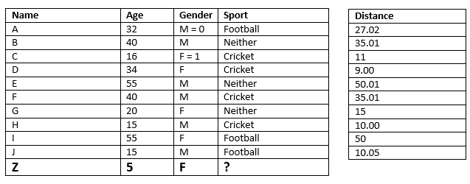
Example-01. Classification
If K = 3, K = 5
Notes:
Classification: Final decision - Mode
Regress: Final Decsion - Mean or Average of the K nearest neighbors

Slide 5
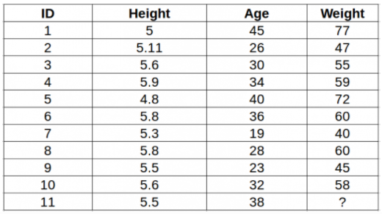
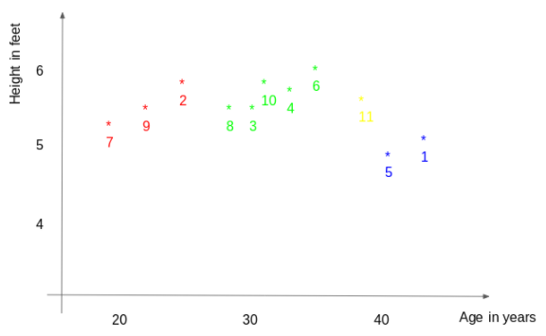
Example-02. Regression

Slide 6
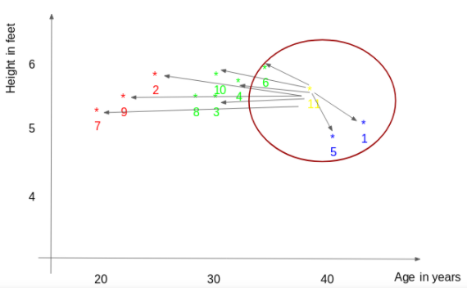
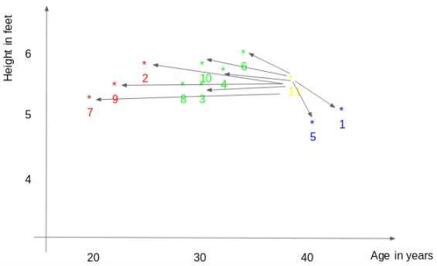
Example02 -Regression
Notes:
Regress: Final Decsion - Mean or Average of the K nearest neighbors = (77(ID1)+72(ID5)+60(ID6))/3 = 69.66 kg.

Slide 7
K-NN Assumption
The KNN algorithm assumes that similar things exist in close proximity. In other words, similar things are near to each other.
KNN captures the idea of similarity (sometimes called distance, proximity, or closeness) with some mathematics — calculating the distance between points on a graph.
Multiple ways of calculating distance b/w two points, and one way might be preferable depending on the problem we are solving. However, the straight-line distance (also called the Euclidean distance) is a popular and familiar choice.

Slide 8
Distance Formula (Euclidean Distance)
Distance between two points
Given the two points (x1, y1) and (x2, y2), the distance d between these points is given by the formula:
d = √[(x2 − x1)² + (y2 − y1)²]
Note: General use case of Distance
Continuous Variable : Euclidean & Manhattan Distance Categorical Variable: Hamming Distance

Slide 9
How does KNN Work?
It considers K Nearest Neighbors ( Data points that have minimum distance in feature space from our new data point) to predict the class or continuous value for the new Datapoint.
K is the number of such data points we consider in our implementation of the algorithm.
Therefore, distance metric and K value are two important considerations while using the KNN algorithm.

Slide 10
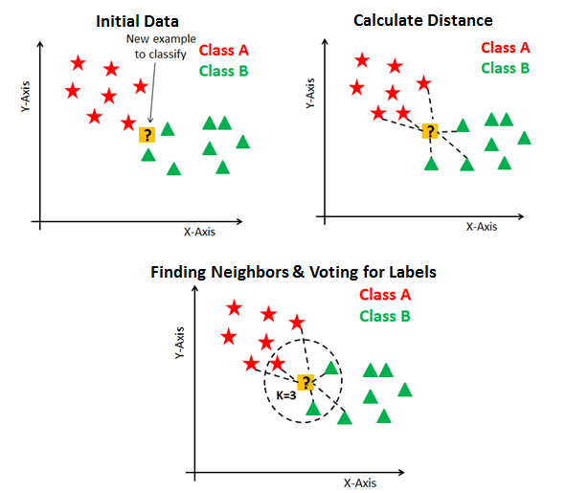

Slide 11
How does KNN Work?
Euclidean distance is the most popular distance metric. You can also use Hamming distance, Manhattan distance, Minkowski distance as per your need. For predicting class/ continuous value for a new data point, it considers all the data points in the training dataset. Finds new data point’s ‘K’ Nearest Neighbors (Data points) from feature space and their class labels or continuous values.
Then:
For classification: A class label assigned to the majority of K Nearest Neighbors from the training dataset is considered as a predicted class for the new data point.
For regression: Mean(in case of normal distribution) or median(in case of skewed distribution, bcz then it is a better measure of central tendency) of continuous values assigned to K Nearest Neighbors from training dataset is a predicted continuous value for our new data point
Notes:
When you have a skewed distribution, the median is a better measure of central tendency than the mean.

Slide 12
KNN Model Representation
The model representation for KNN is the entire training dataset.
KNN has no model other than storing the entire dataset, so there is no learning required.
Efficient implementations can store the data using complex data structures like k-d trees to make look-up and matching of new patterns during prediction efficient.
KNN makes predictions using the training dataset directly.
To determine which of the K instances in the training dataset are most similar to a new input a distance measure is used. For real-valued input variables, the most popular distance measure is Euclidean distance.
Euclidean is a good distance measure to use if the input variables are similar in type (e.g. all measured widths and heights). Manhattan distance is a good measure to use if the input variables are not similar in type (such as age, gender, height, etc.).

Slide 13
KNN is a lazy learning and non-parametric algorithm.
It's called a lazy learning algorithm or lazy learner because it doesn't perform any training when you supply the training data. Instead, it just stores the data during the training time and doesn't perform any calculations. It doesn't build a model until a query is performed on the dataset. This makes KNN ideal for data mining.
It's considered a non-parametric method because it doesn’t make any assumptions about the underlying data distribution. Simply put, KNN tries to determine what group a data point belongs to by looking at the data points around it.
In the case of KNN’s, and all instance based learners, we don’t pre-compute a model/interpretation of the data. Instead, we just store the data to be used on prediction evaluation.
--- lazy algorithm, i.e., it suggests that it memorizes the training data set rather than learning a discriminative function from the training data.
---non-parametric model: Non-parametric means there is no assumption for underlying data distribution i.e. the model structure is determined from the dataset.

Slide 14
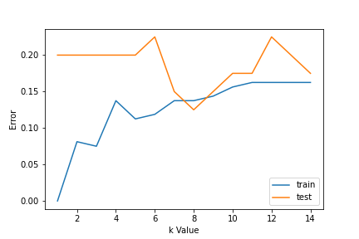
How to choose the value for K?
To select the K that’s right for your data, we run the KNN algorithm several times with different values of K and choose the K that reduces the number of errors we encounter while maintaining the algorithm’s ability to accurately make predictions when it’s given the data, it hasn’t seen before.
Using error curves
Domain Knowledge
Binary classification, K = odd
OR
To avoid a tie;
Even number of classes -- k odd
Odd number of classes -- k even

Slide 15
Overfitting & Underfitting
Overfitting imply that the model is well on the training data but has poor performance when new data is coming.
Underfitting refers to a model that is not good on the training data and also cannot be generalized to predict new data.
Note: It’s very important to have the right k-value when analysing the dataset to avoid overfitting and underfitting of the dataset.

Slide 16
Required Data Preparation
1. Data Scaling: To locate the data point in multidimensional feature space, it would be helpful if all features are on the same scale. Hence normalization or standardization of data will help. (standardize if data has normal distribution)
2. Dimensionality Reduction: KNN may not work well if there are too many features. Hence dimensionality reduction techniques like feature selection, principal component analysis can be implemented.
3. Missing value treatment: If out of M features one feature data is missing for a particular example in the training set then we cannot locate or calculate distance from that point. Therefore deleting that row or imputation is required.

Slide 17
Curse of Dimensionality
KNN works well with a small number of input variables (p), but struggles when the number of inputs is very large.
In high dimensions, points that may be similar may have very large distances. All points will be far away from each other and our intuition for distances in simple 2 and 3-dimensional spaces breaks down. This might feel unintuitive at first, but this general problem is called the “Curse of Dimensionality“.

Slide 18
Use Case: what Kind of problem it can solve?
KNN is simple, easy-to-implement supervised machine learning algorithm that can be used to solve both
Classification Problems
Regression Problems
Search Problem

Slide 19
KNN Pros & Cons
Pros:
The algorithm is simple and easy to implement.
There’s no need to build a model, tune several parameters, or make additional assumptions.
The algorithm is versatile. It can be used for classification, regression, and search
Cons:
The algorithm gets significantly slower as the number of examples and/or predictors/independent variables increase.
as the volume of data increases it makes it an impractical choice in environments where predictions need to be made rapidly.
useful in solving problems that have solutions that depend on identifying similar objects. E.g. recommender systems, an application of KNN-search.
major drawback of becoming significantly slows as the size of that data in use grows.

Slide 20
KNN application - Recommender Systems
Recommender System: Recommending products on Amazon, articles on Medium, movies on Netflix, or videos on YouTube. Although, we can be certain they all use more efficient means of making recommendations due to the enormous volume of data they process. However, we could replicate one of these recommender systems on a smaller scale using KNN
Loan approval:
Credit rating:
Data preprocessing:
Task: Given a movies data set, what are the 5 most similar movies to a movie query?

Slide 21
Summary
KNN stores the entire training dataset which it uses as its representation.
KNN does not learn any model.
KNN makes predictions just-in-time by calculating the similarity between an input sample and each training instance.
There are many distance measures to choose from to match the structure of your input data.
It is a good idea to rescale your data, such as using normalization, when using KNN.

Slide 22
